Slide 1
Creative Ways to Reach Donors
Jared Bulluck
Sr. Director of Operations
jbulluck@leadershipmemphis.org

Slide 2
Ask yourself one question?
What impact would the community have if my organization did not exist?

Slide 3
Videos

Slide 4
Donation Form
Easy to use
Highly visible
On every page and every communication

Slide 5
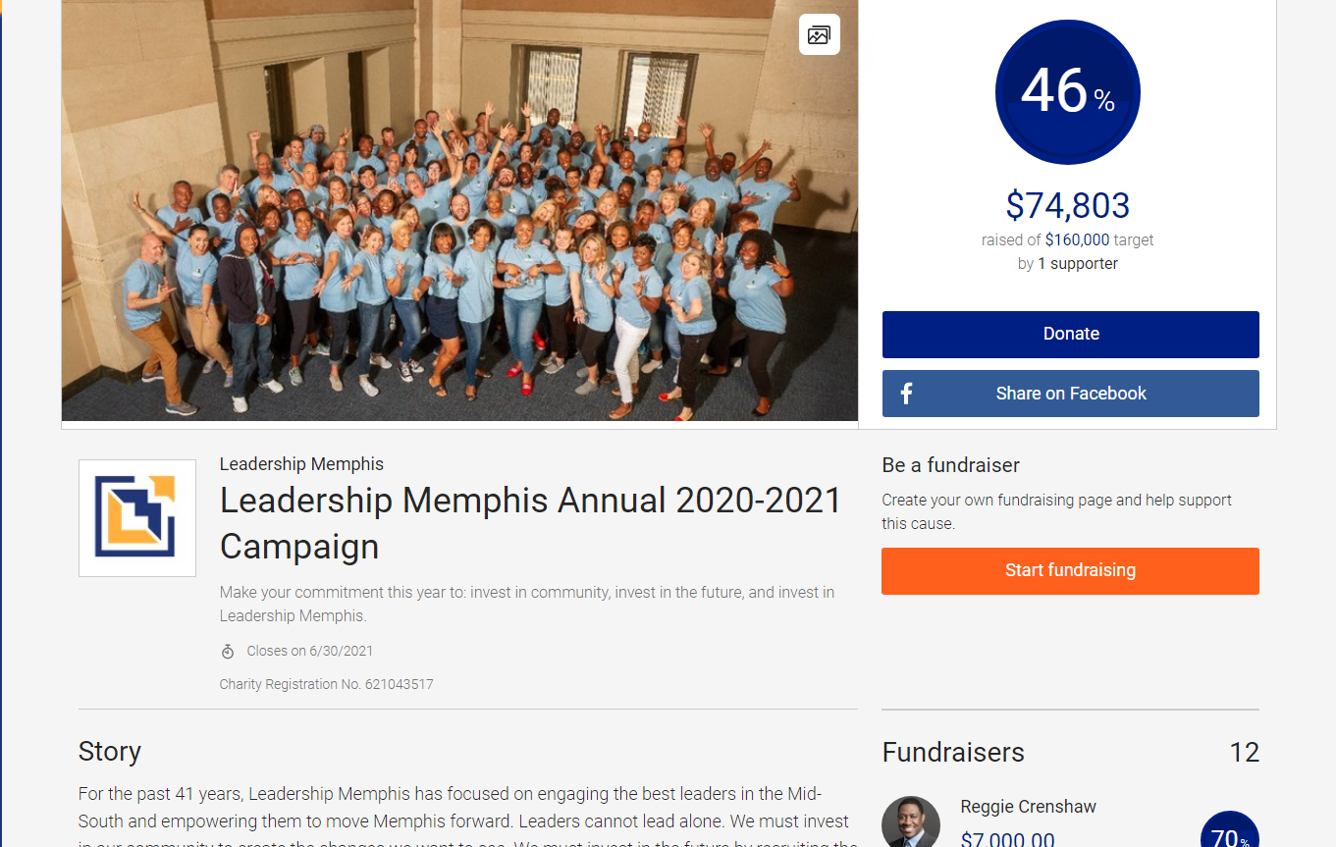
Peer 2 Peer Fundraising

Slide 6
Social Media
Constant and consistent communication
Set goals and continue to communicate the status
Create a group of brand ambassadors to share and comment
Set modest goals for your ambassadors to achieve success
Make it fun!

Slide 7
Donor Retention
Be sure to keep your current donors updated about your programs and events
Reach out to your donors and do not ask them for money
Thank them personally and publicly

Slide 8
Other Fun and Creative Fundraisers
Virtual Concert
Online Dinner
Online Auction
Virtual Marathon/Workout
Virtual Trivia
Virtual Workshop/Class
Donation Matching
Virtual Movie Night

Slide 9
Cares Act and Non-Cares Act Grants
Federal Grants
State of Tennessee
Local Community Grants
Foundations

Slide 10
Ask yourself one question?
What impact would the community have if my organization did not exist?

Slide 11
Contact Us
Jared Bulluck
Sr. Director of Operations
jbulluck@leadershipmemphis.org
901-233-2496
Leadershipmemphis.org

