Slide 1
Recruitment while Social Distancing

Slide 2
L’Evate – A Leadership Community
Who Are We?
What was the norm for our recruitment efforts?
How did the year start?
What happened next?
Did we get a great class?
What are we doing about recruiting for 2022?

Slide 3
Who Are We?
An independent community leadership program
Service area includes communities within Nashville
Created in 1997 - currently nearly 600 alumni
Normal Recruitment Efforts
Year round effort – Always think about recruitment
Recruitment Team collects names from Alumni
One on one calls and visits
LeadUP

Slide 4
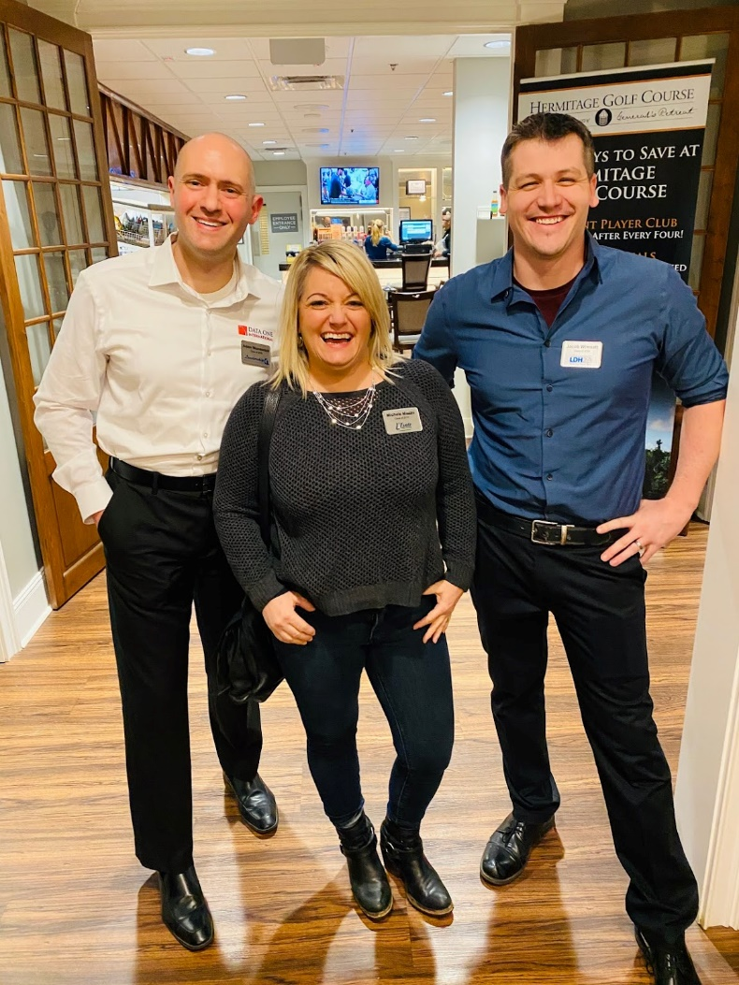
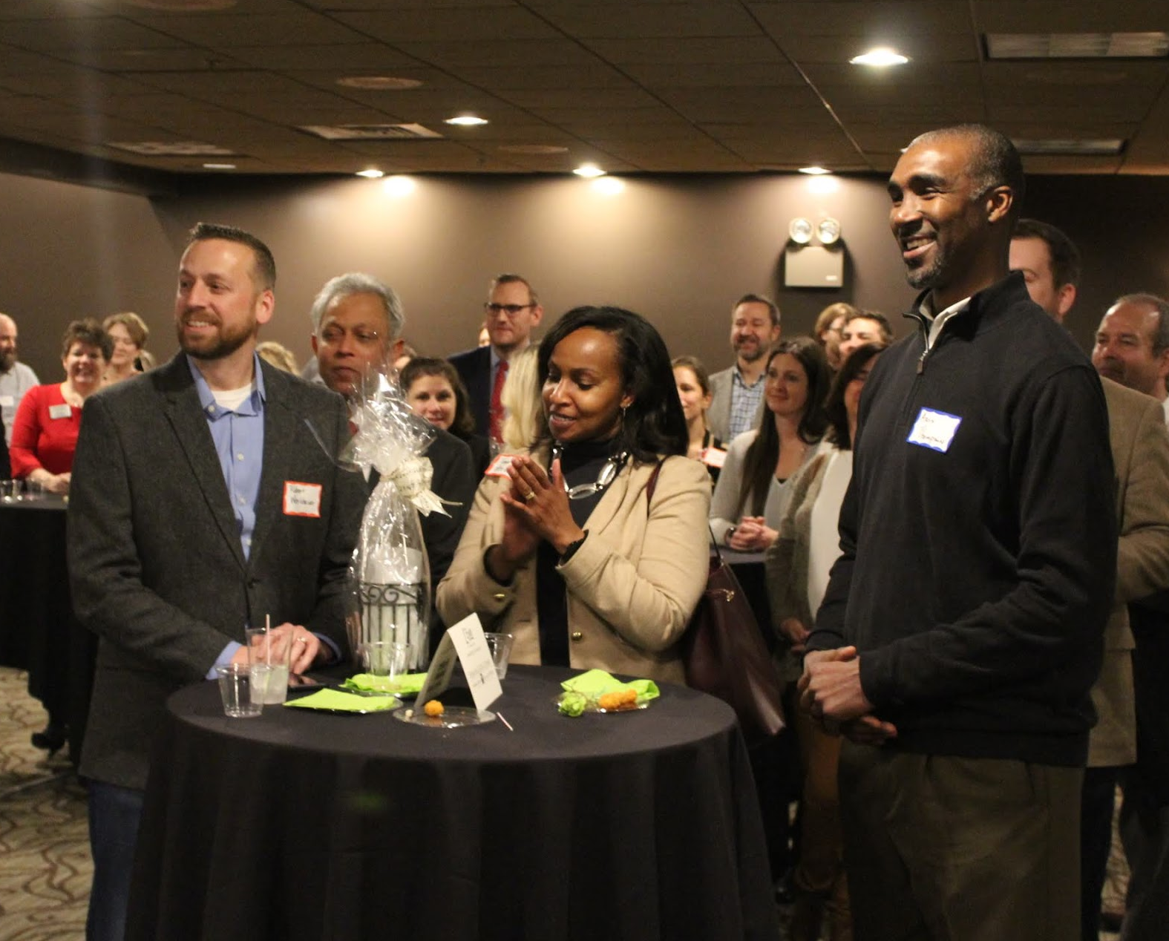
On TOP of the WORLD! March 2, 2020
Hermitage Golf Course
Clubhouse Reception

Slide 5
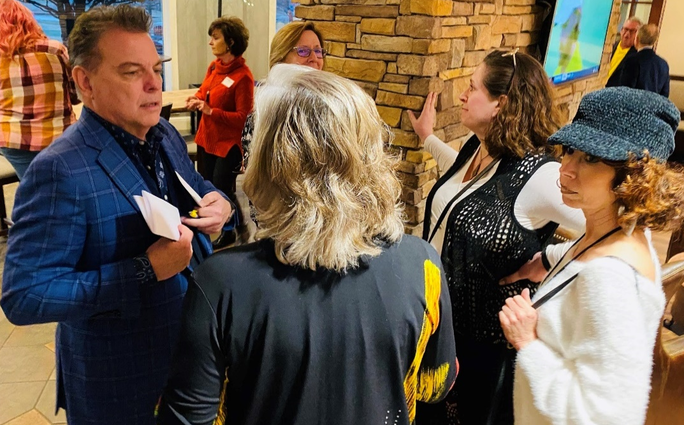
Great Crowd
Great Networking
Great Prospects
Room full of Alumni and their guests
Perfectly NORMAL start to our Recruitment efforts!

Slide 6
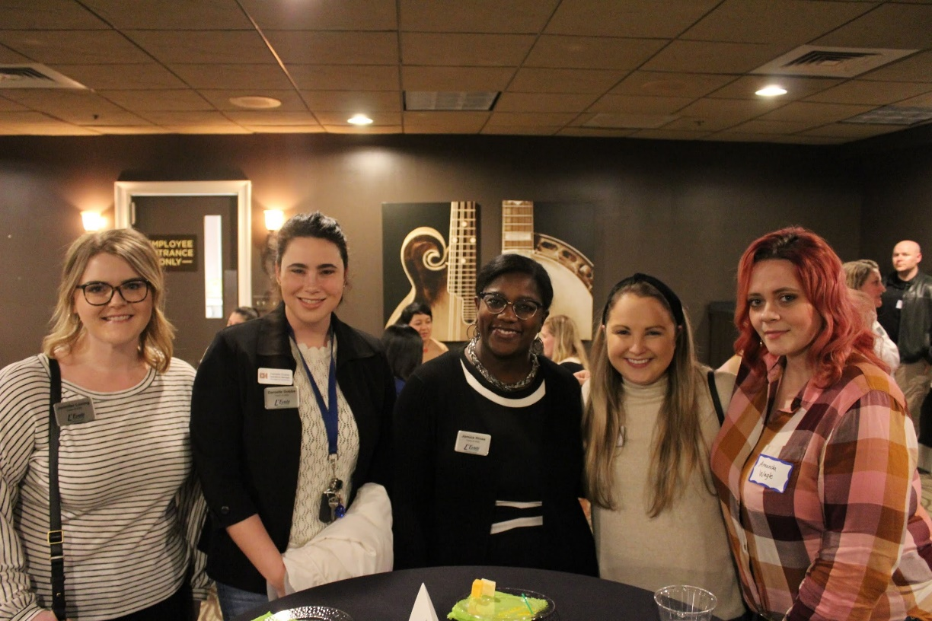
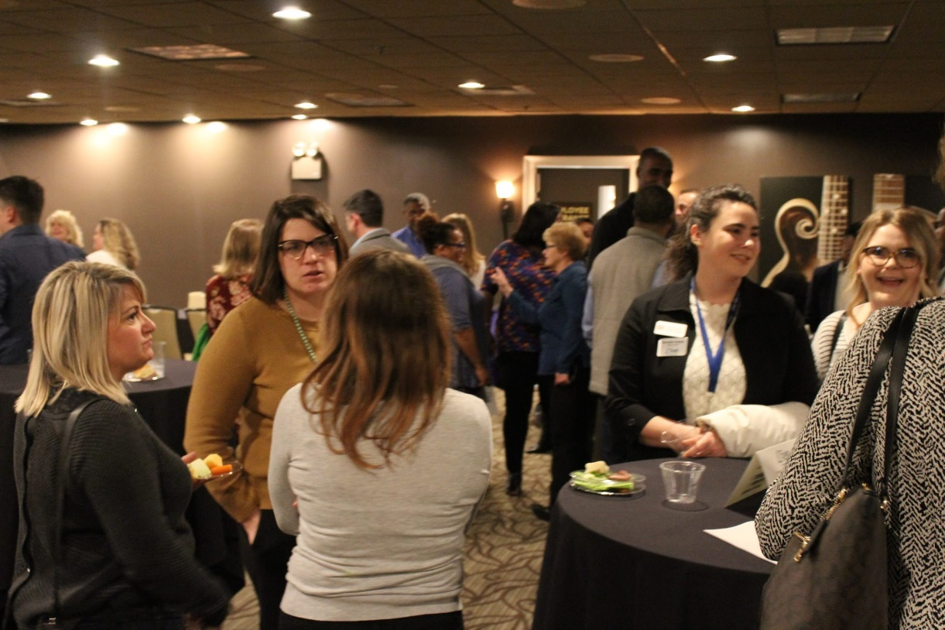
So much Energy in the Room!

Slide 7
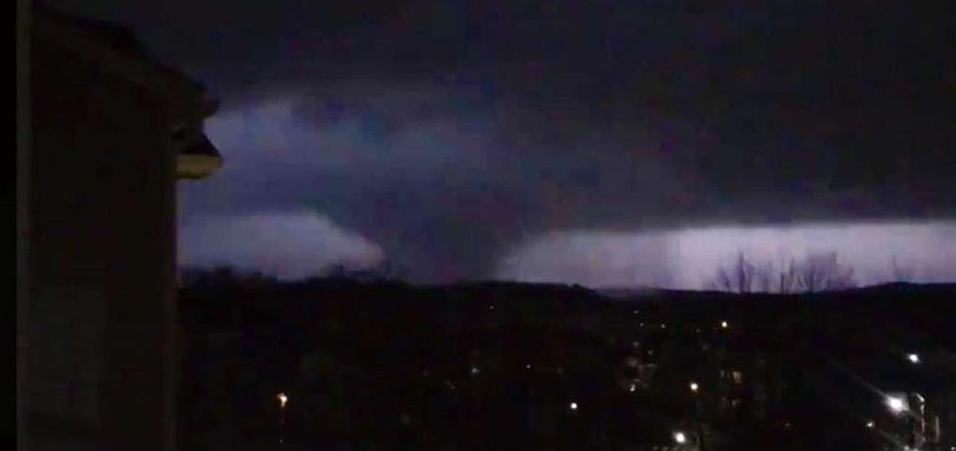
Early in the morning of March 3, 2020

Slide 8
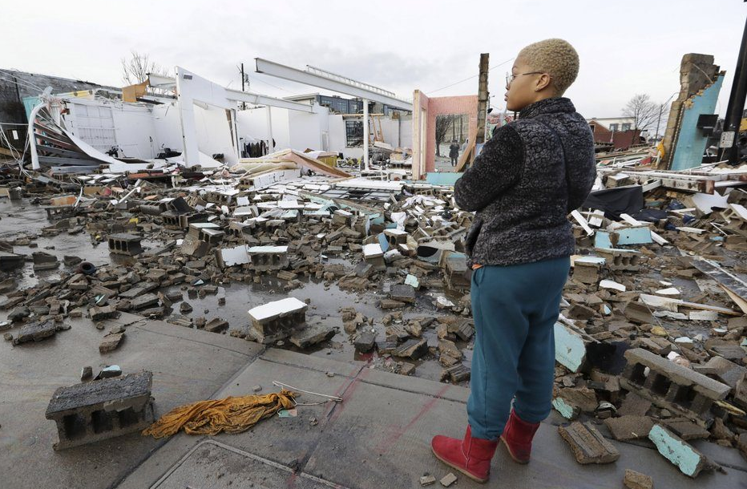

Slide 9
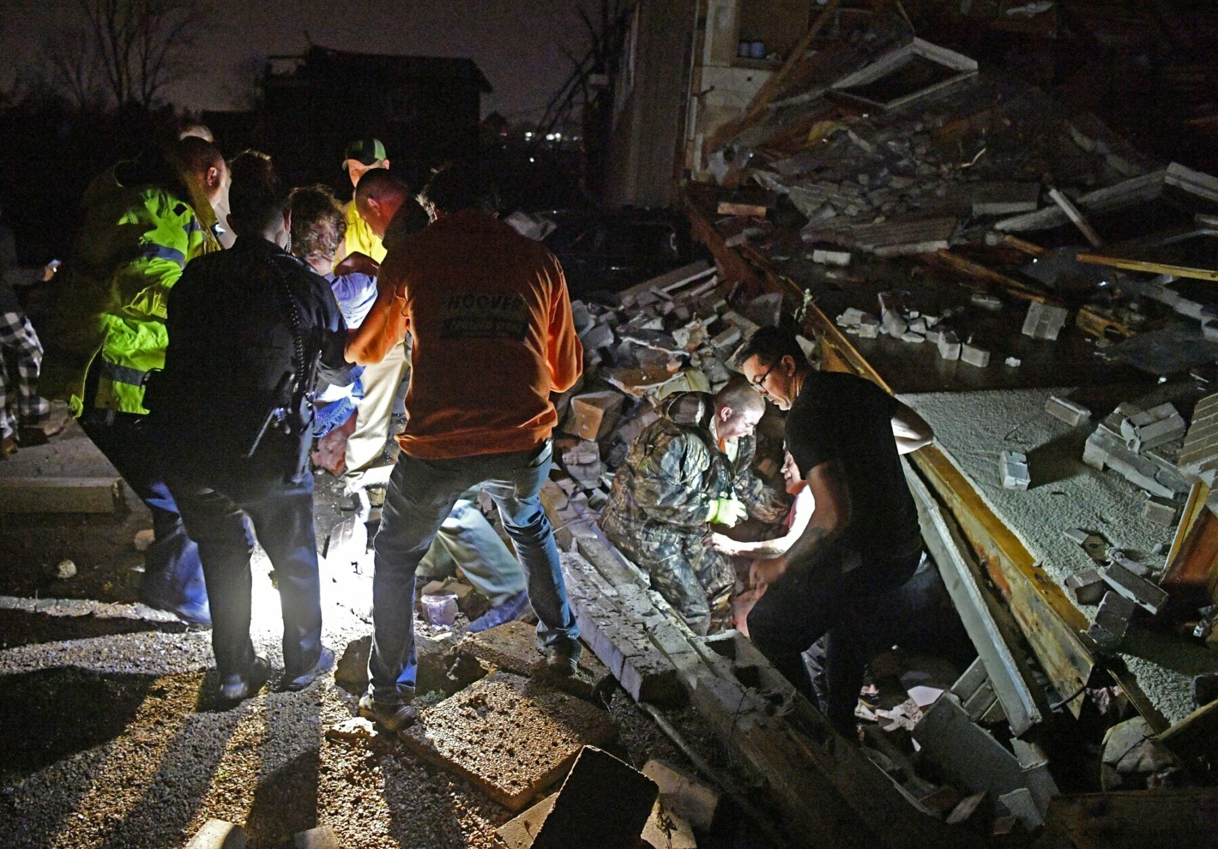

Slide 10
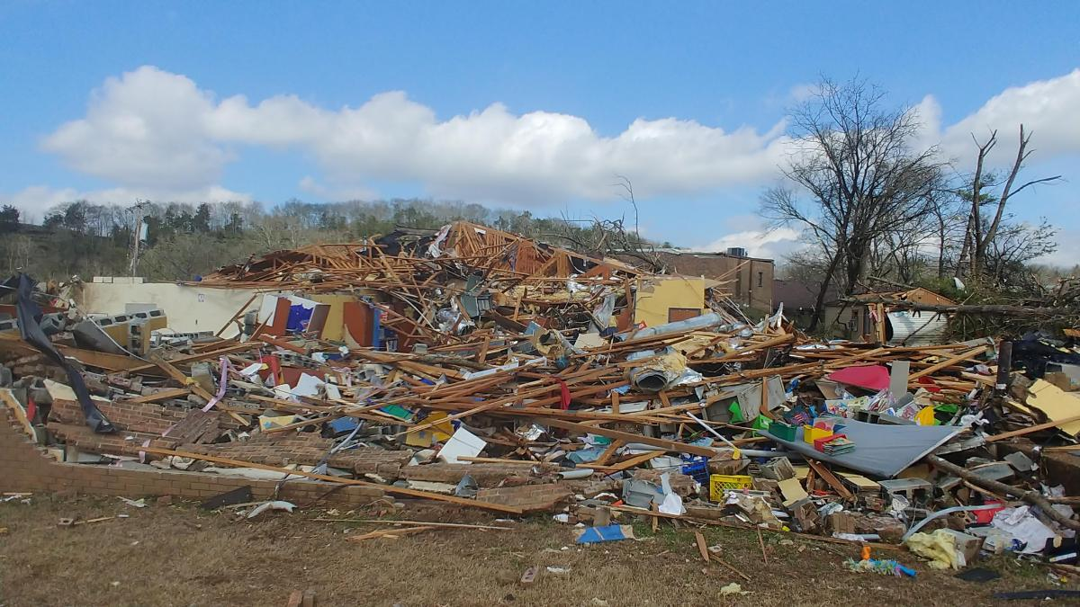

Slide 11
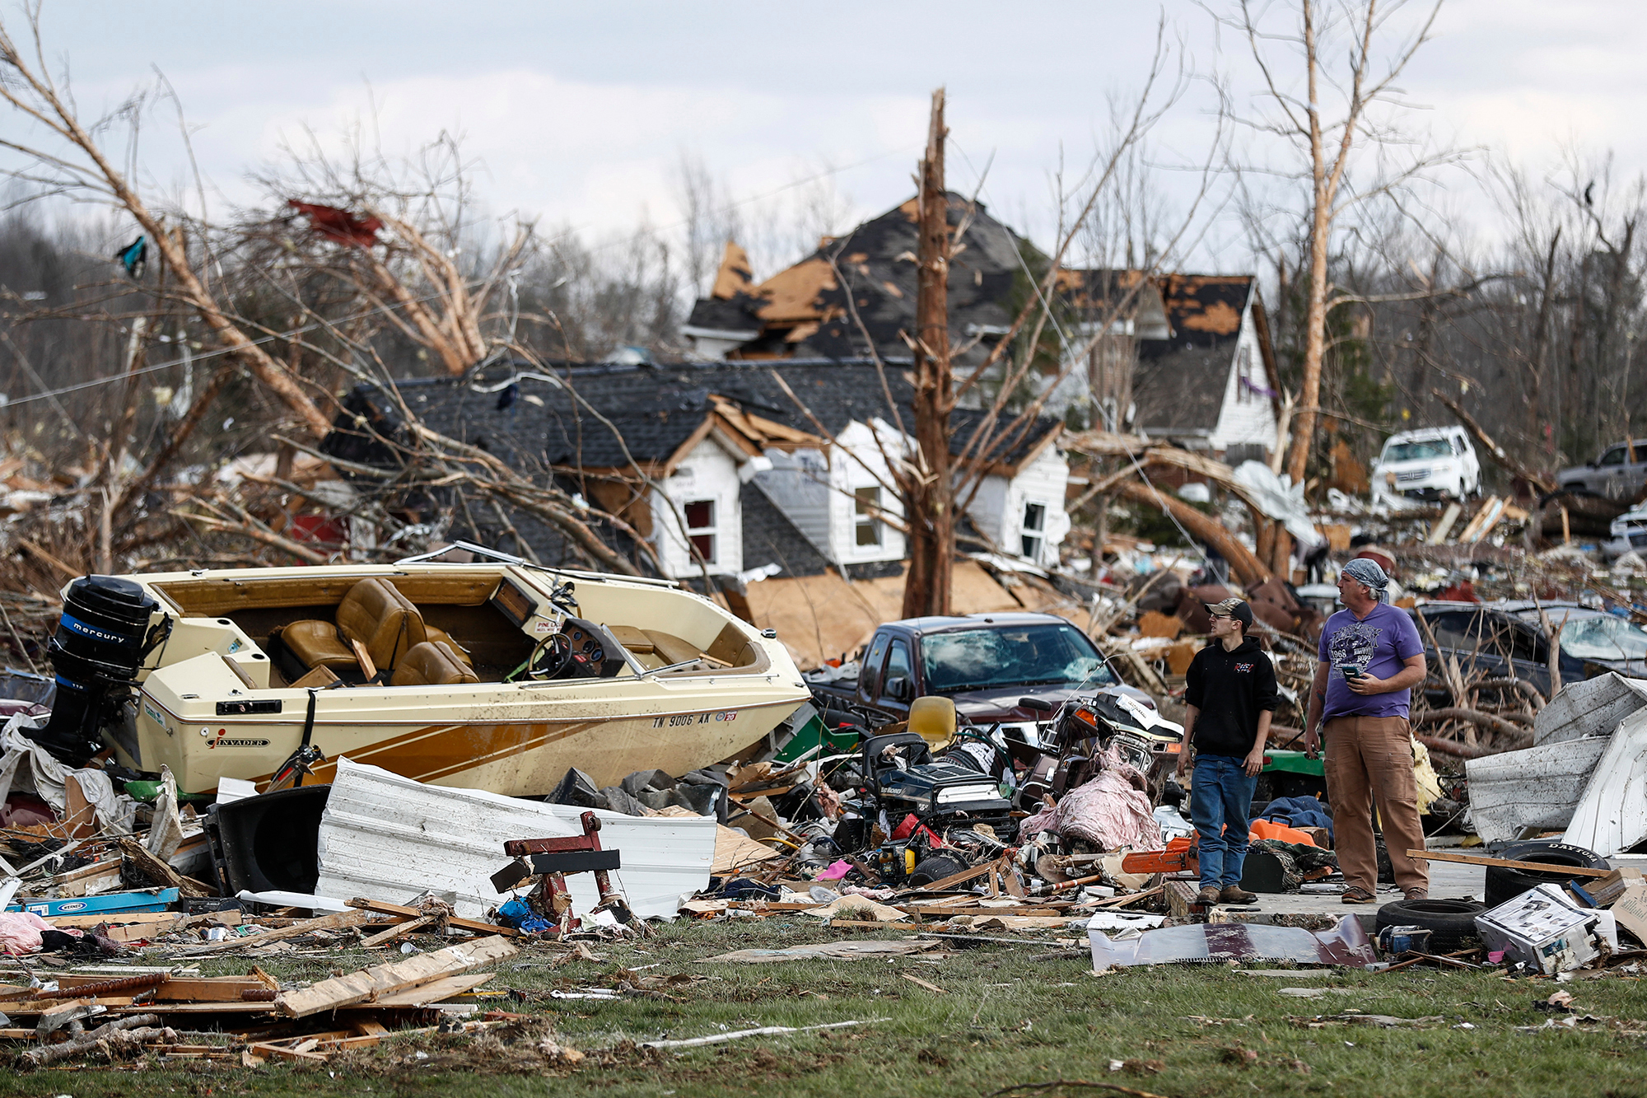

Slide 12
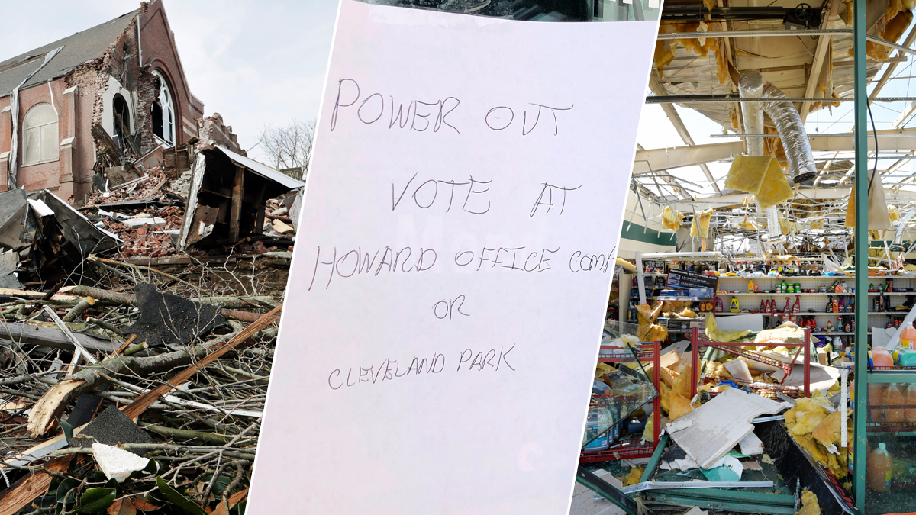

Slide 13
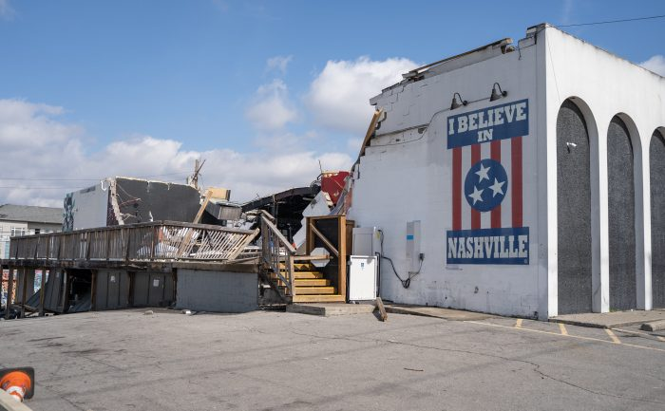

Slide 14
And Then - Covid-19

Slide 15
So what did we do?
Organized our team
Look at our current prospect list – how many did we lose
Assess our position
Contact ALL alumni and asked for their help recruiting
Remember – it used to be all word of mouth recruitment
Meet weekly with the core team
Ask for reports and challenge everyone to do their part
Provide updates to Board Members and ask for their help
The program director HAS to make calls too
Be ready to PIVOT when the unknown happens

Slide 16
Did we get that great class?

Slide 17
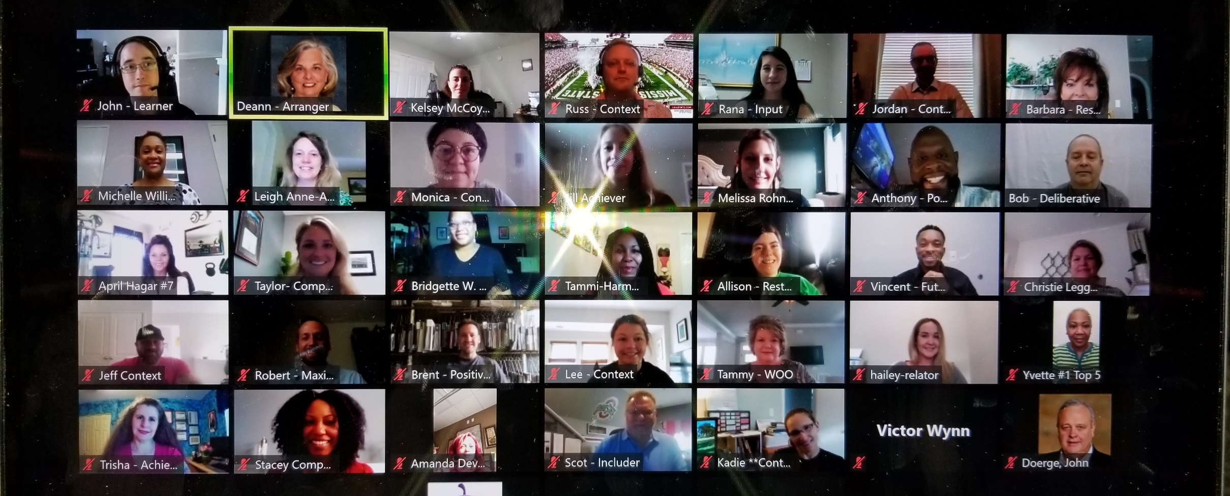
AMAZING - Class of 2021 – Retreat

Slide 18
Recruitment for the next Class?
Pray for some normalcy
Continue the course and follow our
successful history
Pull together that special group of people who have the strengths we need do make this work
Practice time proven word of mouth recruitment
Contact those we were recruiting who could not participate this year
Never GIVE UP!

